Slide 1
Customer Purchase Analysis & Segmentation
Project: CDACL-002 | Tool: Power BI | Analyst: Prashant Sakhare

Slide 2

Dataset Overview
Source: Shopping dataset (3,900 records)
Key Fields: Age, Gender, Category, Purchase Amount, Discounts, Subscription, Location
Objective: Analyze customer trends, evaluate discount strategies, and build customer segments

Slide 3
Business Performance Summary
Total Sales: $233K
Unique Customers: 3,900
Repeat Customers: 97.87% – very strong loyalty
Avg. Purchase: $59.76
Avg. Rating: 3.75/5
Discount Usage: 43% of all purchases used a discount
✅ This shows your store is doing well, especially with customer retention. But there is heavy reliance on seasonal trends and discounts.

Slide 4
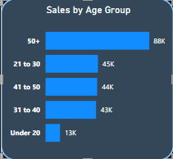
Age Group Performance
Top Spending Group: 21–50 age range (Around 57% Combined)
Followed by 50+ age group (37%)
Under 20 spends the least (5.36%)
✅ Ideal target audience is 21 to 50 years old. They respond well to your offerings and promotions.

Slide 5
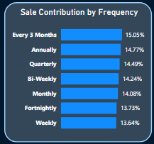
Frequency of Purchases
Sales are well spread across Weekly, Fortnightly, Monthly, Quarterly, etc.
No single frequency dominates (all around 13%–15%)
✅ This indicates a consistent shopping pattern. You can create specific offers based on frequency — like “every 2 weeks get a deal” or “monthly bundles.”

Slide 6
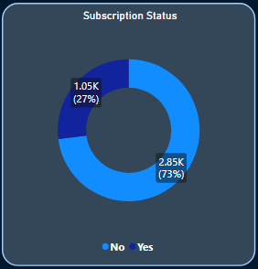
Subscription Insights
73% of sales come from Unsubscribed users
Subscribed customers likely show more loyalty and higher spending
✅ Subscriptions work! You should promote this more — e.g., exclusive deals for members.

Slide 7
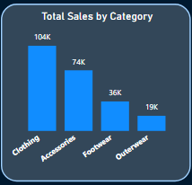
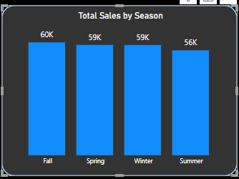
Category-Wise Revenue
Top: Clothing ($104K), Accessories ($74K)
Low: Outerwear ($19K)
✅ Focus campaigns on outerwear — maybe bundled with bestsellers like accessories or shirts.

Slide 8
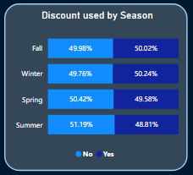
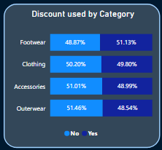
Discount Usage Patterns
Discount Usage: Roughly 50% across all seasons and categories
Very small difference in Avg. Spend:
With discount: $60.13
Without discount: $59.28
✅ This means discounts are not increasing order value — they may be overused. Cut down on random discounts and focus on targeted deals.

Slide 9
Customer Segmentation Insights
Segment | Customers | Revenue | Revenue % | Avg Spend | Discount Usage
Occasional Spender | 1283 | 109797 | 47% | 86 | 35%
Frequent Shopper | 1030 | 46194 | 20% | 45 | 45%
Casual Buyer | 814 | 35608 | 15% | 44 | not specified
Discount Seeker | 609 | 27334 | 12% | 45 | 100%
Loyal High Spender | 164 | 14148 | 6% | 86 | 100%
✅ Frequent Shopper are 26% and contribute 20% revenue due to their low ATS (45$), We can train our salesmen for upsell and cross sell to this segment without hampering their shopping experience and convert these customers into loyal high spenders.

Slide 10

Key Insights (Overall)
97%+ customers are repeat buyers – strong loyalty base
43% of revenue comes from discounted purchases; avg spend similar to non-discounted
Age group 21–40 contributes the most to revenue
Fall & Winter ARE BEST PERFORMING SEASONS
Categories like Clothing & Accessories dominate sales

Slide 11

Customer Segments & Strategy
Loyal High Spenders (164): Create VIP loyalty program with early access, free shipping, exclusive items, retain at all costs
Occasional High Spenders (1,283): Incentivize frequency, upsell with rewards
Frequent Shoppers (1,030): Increase basket size via bundles and cross-sells
Discount Seekers (609): Target with limited-time product-specific deals
Casual Buyers (814): Retargeting, first-time buyer campaigns

Slide 12

Strategic Recommendations
Focus Area | Recommendation
Loyal Customers | Create VIP loyalty program with early access, free shipping, exclusive items
Discount Strategy | Reduce blanket discounts; use time-limited or product-based promo codes
Age-Based Targeting | Focus ads, offers, and bundles on age 21–40 — your biggest spending group
Low-Performing Categories | Bundle or cross-sell Outerwear with Accessories to increase visibility ATS
Subscriptions | Promote more aggressively with benefits like bonus points or free returns
Customer Segments | Use your segmentation logic for tailored email campaigns: Upsell Occasional Spenders Retarget Casual Buyers Send special offers to Discount Seekers during clearance sales

Slide 13

Thank You
For any questions or follow-up:
📧 sakhare96.Prashant@gmail.com
💼 LinkedIn: www.linkedin.com/in/prashant-sakhare-1a645522b
✅ Submitted as part of CDACL-002 Client Project

